Slide 1
Mental Wellbeing

Slide 2
Imagine you have four tanks…
(You might like to think of them as fuel tanks, or test tubes…)
Each tank represents a different part of your wellbeing:
Emotional
Physical
Intellectual
Relational
What do you think each of these four words mean?

Slide 3
How full is your EMOTIONAL tank?
A FULL tank looks like…
I have been feeling mostly happy, and when I have a negative emotion I have healthy ways of dealing with it. It doesn’t affect my whole day or cause my feelings to spiral out of control.
An EMPTY tank looks like…
I have been feeling drained, sad or numb. My emotions are all over the place and change quickly. I overreact to things and feel like my emotions are out of control. I don’t have any good ways of coping.
Questions to help you think about this:
How stable have your emotions been recently?
Have you got close friends or adults to speak to about your feelings?
Have you been feeling overwhelmed by your emotions?
Have you been engaging in any negative or harmful coping mechanisms?
Have you been bottling up your feelings?
Have you been feeling emotionally ‘numb’?

Slide 4
How full is your PHYSICAL tank?
A FULL tank looks like…
I feel full of energy and am sleeping and eating well. I don’t feel unwell and I don’t have any physical injuries that are causing me problems.
An EMPTY tank looks like…
I feel tired or under the weather. I am not looking after my body well and as a result some physical activity is difficult. I am not at my peak.
Questions to help you think about this:
Have you been unwell or injured recently?
Have you been eating healthy balanced meals?
Have you been spending time being active outside?
Are you doing regular exercise?
Are you getting enough sleep and drinking enough water?
Do you have the energy to do all the things you want to do?

Slide 5
How full is your INTELLECTUAL tank?
A FULL tank looks like…
My brain is being challenged just the right amount. I get to use different parts of my brain and stretch my capabilities but not to the extent of being stressed.
An EMPTY tank looks like…
EITHER: I am being challenged too much. I am stressed and overwhelmed by work.
OR: My brain is not being challenged at all. I am bored and unmotivated.
Questions to help you think about this:
How are you finding school lessons at the moment?
Are you managing to do all your homework?
Are you using different parts of your brain – creative, mathematical, strategic, problem solving, etc…?
Are you learning any new skills outside of school?
Have you got anything you are working towards?

Slide 6
How full is your RELATIONAL tank?
A FULL tank looks like…
I’m getting just the right amount of social time. The time I spend with my friends and family makes me feel loved and included. I have people to share my happy and sad feelings with.
An EMPTY tank looks like…
I am lonely and not getting enough social interaction, or the social interaction I am getting is not positive. It leaves me exhausted or feeling bad about myself. It is not meeting my needs.
Questions to help you think about this:
How much time are you spending with friends and family?
How much time do you have to rest on your own?
Do you have people to talk to about your feelings?
Do you have people to hang out with and have fun with?
Are you having lots of arguments with friends or family?
Do your friends and family make you feel good about yourself?

Slide 7
Now that you have considered each tank in turn…
REFLECT
Which one is fullest?
Which one is emptiest?
What can you do to ‘fill’ the ones that are getting empty?

Slide 8
Ideas for filling your tanks
EMOTIONAL
Keep a diary of your feelings, speak to someone you trust about how you feel, be kind to yourself, do something that makes you feel happy, get outside more, help someone else
PHYSICAL
Eat balanced meals, drink lots of water, get at least 8 hours of sleep each night, do regular exercise, get outside every day, keep up your hygiene to prevent getting ill, rest when you need to
INTELLECTUAL
Do your best in every lesson, plan out your evenings so you have time for homework as well as rest, do something creative every week, learn something new, ask for help when you need it
RELATIONAL
Arrange to meet up with a friend, look out for others who might be lonely, don’t spend all your time at home in your room, talk about your feelings, give more hugs, encourage others and be kind

Slide 9
What one thing will you do differently this week to boost your mental wellbeing?

Slide 10
Extension: Thoughts and Worries
Watch one of these two videos
Y7 and Y8
https://www.youtube.com/watch?v=0QXmmP4psbA
Y9 and Y10
https://www.youtube.com/watch?v=QTsUEOUaWpY

Slide 11
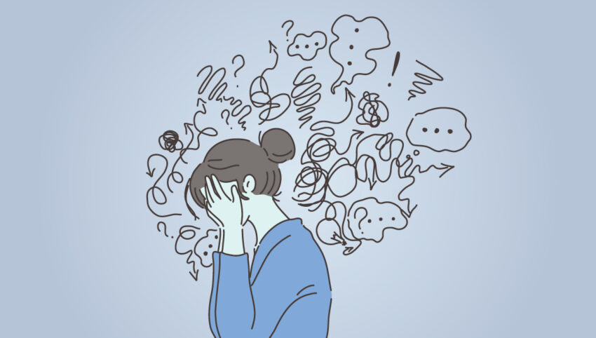
What advice did the video give about how to cope when our head is full of thoughts and worries?

Slide 12
‘Grounding’
Sometimes when we are anxious or stressed our thoughts get out of control. We might start to panic or think about the worst case scenario.
When this happens, we aren’t usually focused on the present moment and this can make us spiral. We need to be ‘grounded’.
Grounding is a way to bring our mind back to the present moment to help control our anxious thoughts.
Try the grounding activity on the following slide. This is something you can do in your head every time you feel overwhelmed.

