Slide 1
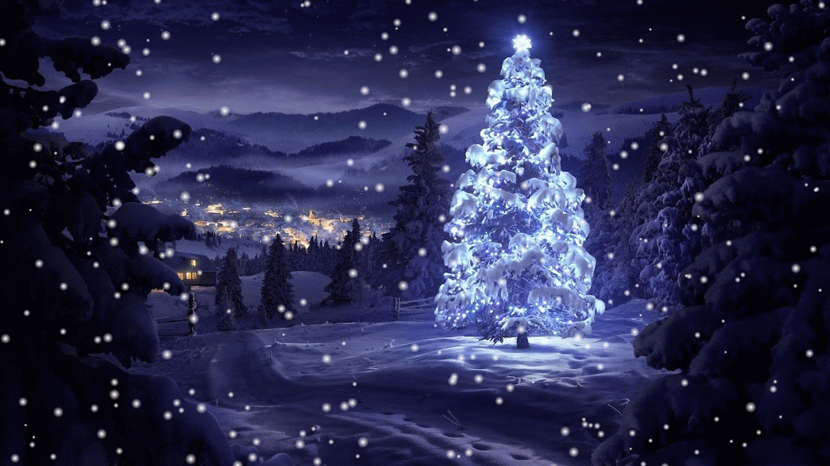
8
3
2
14
10
11
1
17
15
16
18
4
7
9
Virtual Advent Calendar

Slide 2
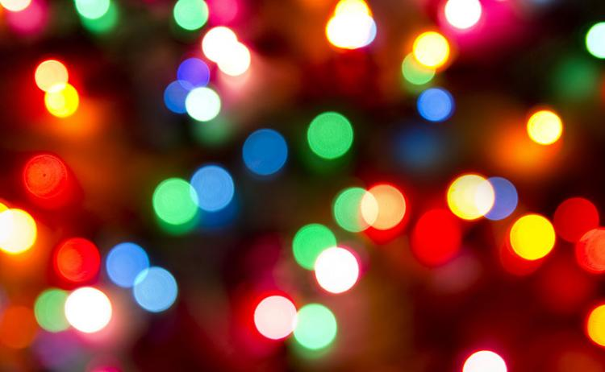
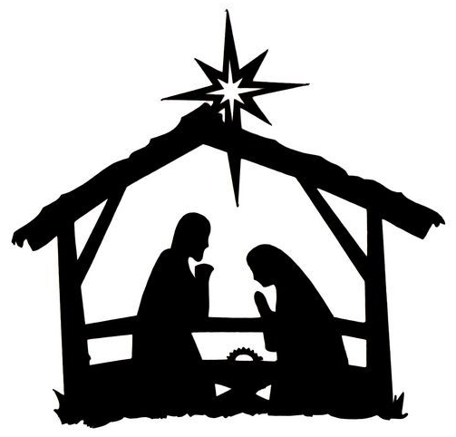
Tuesday 1st December
Don’t forget today’s treats!
JOKE
What do snowmen eat for breakfast?
SNOWFLAKES!
Click to reveal answer
Click here for the Nativity story today
Back to main calendar

Slide 3
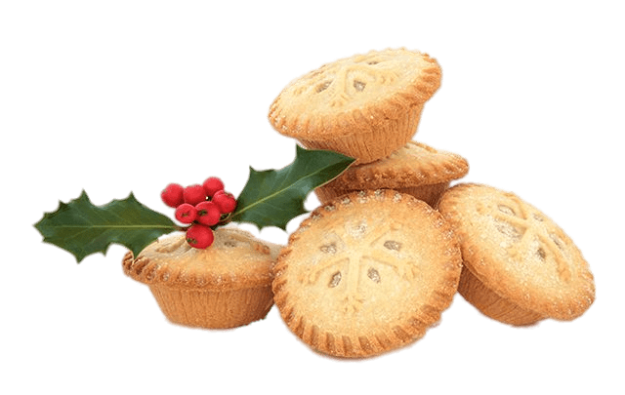
Wednesday 2nd December
Don’t forget today’s treats!
FACT
It’s technically illegal to eat mince pies on Christmas Day in England. In the 17th century, Oliver Cromwell banned Christmas pudding, mince pies and anything to do with greed. The law has never been withdrawn!
Click here for the Nativity story today
Back to main calendar

Slide 4
Thursday 3rd December
Don’t forget today’s treats!
DISCUSS
Advent is all about preparing for something. How do you prepare for Christmas in your household?
(When do you put up the tree? Do you have any family traditions? Do you leave your shopping until the last minute?! Do you go to any special events or places?)
Click here for the Nativity story today
Back to main calendar

Slide 5
Friday 4th December
Don’t forget today’s treats!
QUIZ
Choose a Christmas quiz to complete together:
https://www.sporcle.com/games/subcategory/christmas
Click here for the Nativity story today
Back to main calendar

Slide 6
Monday 7th December
Don’t forget today’s treats!
CHALLENGE
Spread some Christmas cheer this week!
Who could you cheer up? Do you have a neighbour who lives alone? Or a relative you’ve not spoken to for a while? Is there someone you know going through a hard time? How can you help to cheer them up?
Click here for the Nativity story today
Back to main calendar

Slide 7
Tuesday 8th December
Don’t forget today’s treats!
JOKE
What is Rudolph’s favourite day of the year?
RED NOSE DAY!
Click to reveal answer
Click here for the Nativity story today
Back to main calendar

Slide 8
Wednesday 9th December
Don’t forget today’s treats!
FACT
It is a myth that the abbreviation ‘Xmas’ is anti-Christian. The Greek letter X (chi) is an abbreviation for Christ.
Click here for the Nativity story today
Back to main calendar

Slide 9
Thursday 10th December
Don’t forget today’s treats!
DISCUSS
What was the best present you ever received for Christmas and why?
Click here for the Nativity story today
Back to main calendar

Slide 10
Friday 11th December
Don’t forget today’s treats!
SNOWFLAKES!
Decorate your form room with Christmassy snowflakes. You will need A4 white paper and scissors.
Follow these instructions if necessary: https://www.firstpalette.com/craft/paper-snowflake.html
Click here for the Nativity story today
Back to main calendar

Slide 11
Monday 14th December
Don’t forget today’s treats!
CHRISTMAS SONG
Vote on your favourite Christmas song as a class and have a festive sing-a-long:
All I want for Christmas is you
Merry Christmas Everyone
Last Christmas
Rockin’ around the Christmas tree
Let it snow
Click here for the Nativity story today
Back to main calendar

Slide 12
Tuesday 15th December
Don’t forget today’s treats!
JOKE
What Christmas carol is heard in the desert?
O CAMEL YE FAITHFUL!
Click to reveal answer
Click here for the Nativity story today
Back to main calendar

Slide 13
Wednesday 16th December
Don’t forget today’s treats!
FACT
Christmas trees usually grow for around 15 years before they are sold, so your tree this year could be older than you!
Click here for the Nativity story today
Back to main calendar

Slide 14
Thursday 17th December
Don’t forget today’s treats!
DISCUSS
As we come to the end of the year…
What are you most proud of doing or achieving this year?
What would you do differently if you could go back in time?
What will be your New Year’s resolution?
Click here for the Nativity story today
Back to main calendar

Slide 15
Friday 18th December
Don’t forget today’s treats!
CHRISTMAS JOY
Believe us when we say, teachers have had a hard time this term. We want to show them some appreciation. Write a note to one (or more!) of your teachers to encourage them or say thank you to them and make sure you give it to them before the end of the day!
Click here for the Nativity story today
Back to main calendar

Slide 16
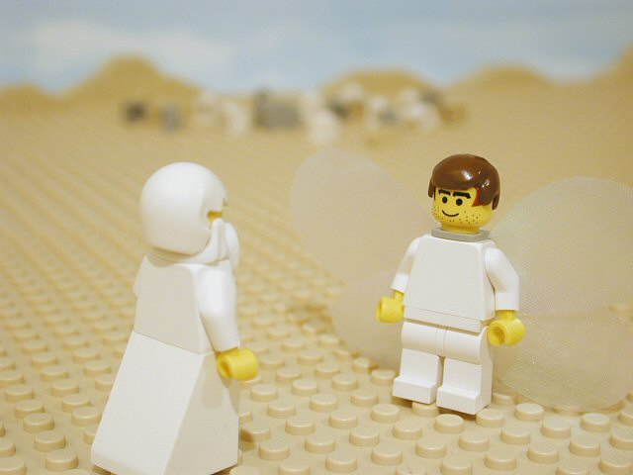
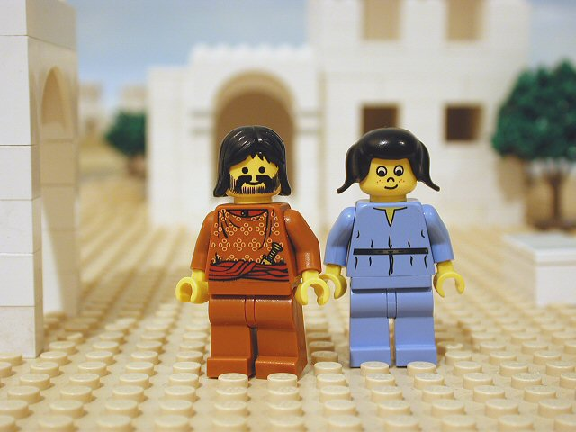
Back to main calendar
1st DECEMBER
Matthew 1:18, Luke 1:26 This is how Jesus Christ came to be born. God sent the angel Gabriel to a town in Galilee called Nazareth.
Luke 1:27 The angel came to a woman named Mary who was engaged to Joseph, a descendant of King David.

Slide 17
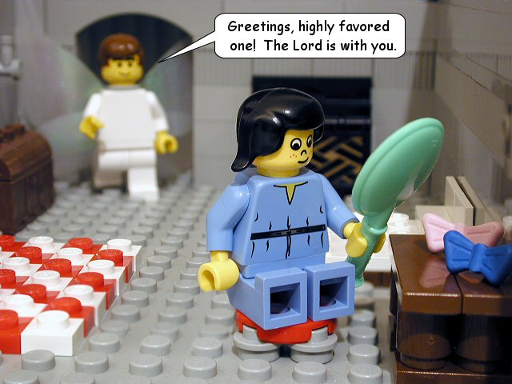
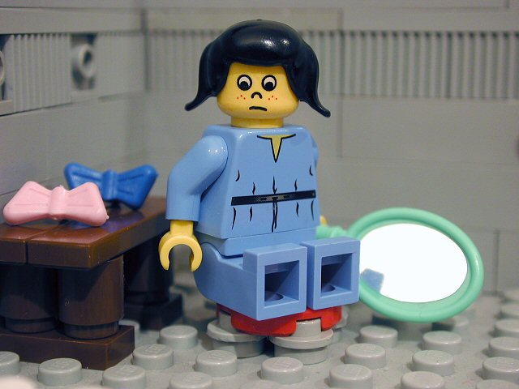
Back to main calendar
2nd DECEMBER
Luke 1:28 The angel came to her and said, 'Greetings, highly favoured one! The Lord is with you.'
Luke 1:29 Mary was greatly troubled by his words, and wondered what this sort of greeting might mean.

Slide 18
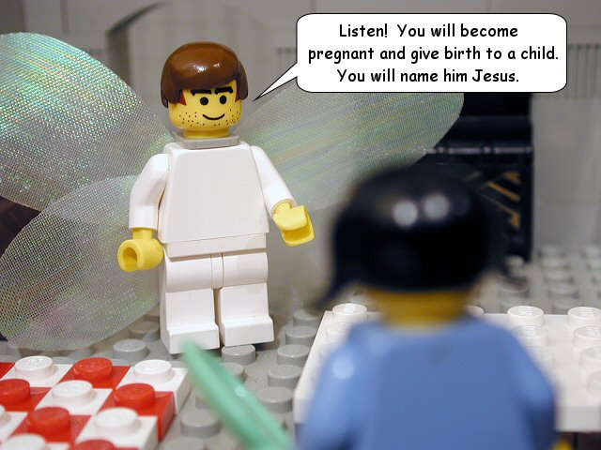
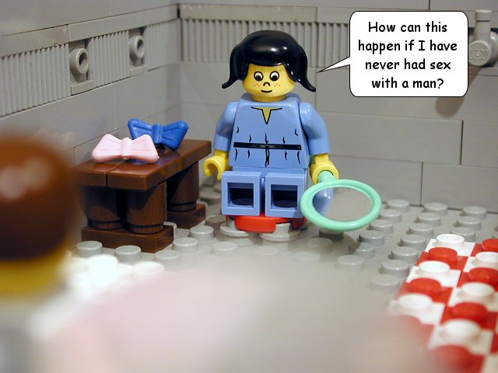
Back to main calendar
3rd DECEMBER
Luke 1:30-31 The angel said to her, “Listen! You will become pregnant and give birth to a child. You will name him Jesus.”
Luke 1:34-35 Mary said to the angel, “How can this happen since I am a virgin?” The angel answered, “The Holy Spirit will come to you and the holy one to be born will be called the Son of God.”

Slide 19
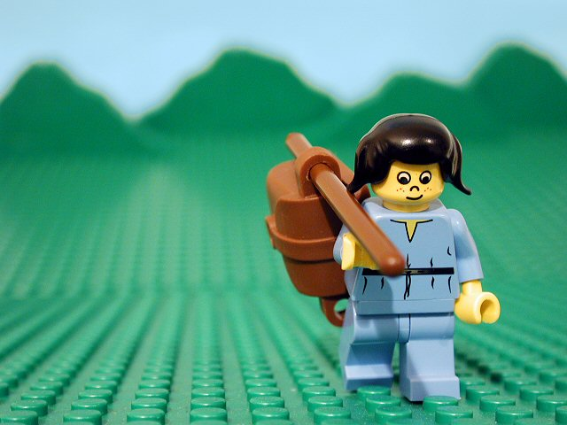
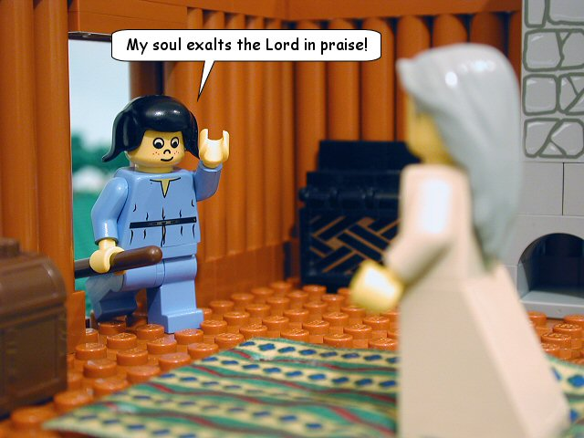
Back to main calendar
4th DECEMBER
Luke 1:39 Shortly afterward, Mary got up and hurried off to the hill country to see her relative Elizabeth who was 6 months pregnant.
Luke 1:40-41 When Mary greeted Elizabeth, Elizabeth was filled with the Holy Spirit and the baby leaped in her womb.

Slide 20
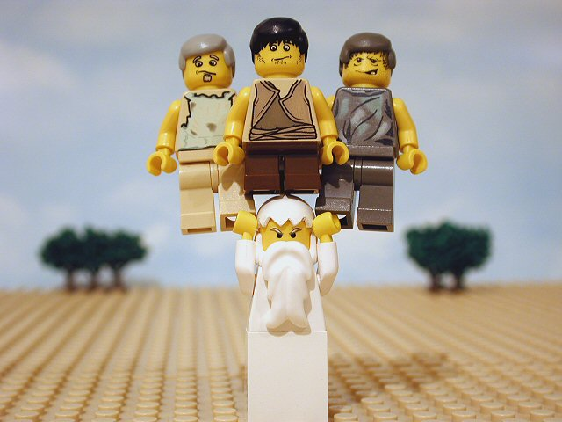
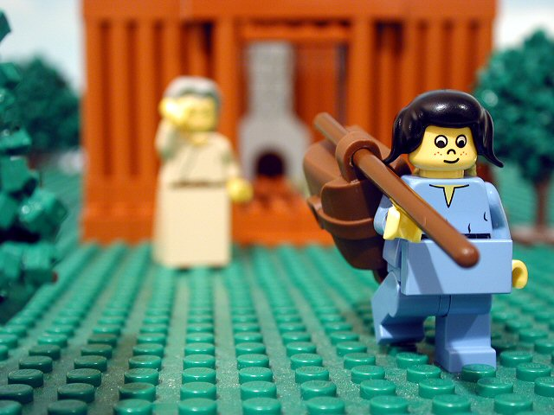
Back to main calendar
7th DECEMBER
Luke 1:46-55 Mary sang a song of praise and joy about how God had raised up the poor and lowly, and that nations will call her blessed from now on.
Luke 1:56 Mary remained with Elizabeth for about three months, and then returned home.

Slide 21
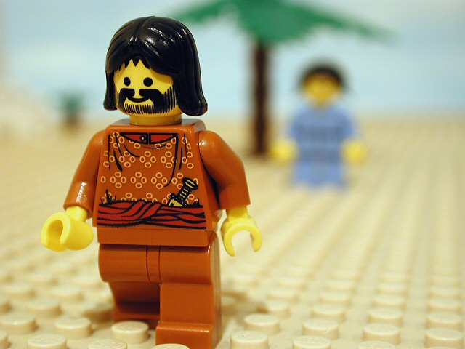
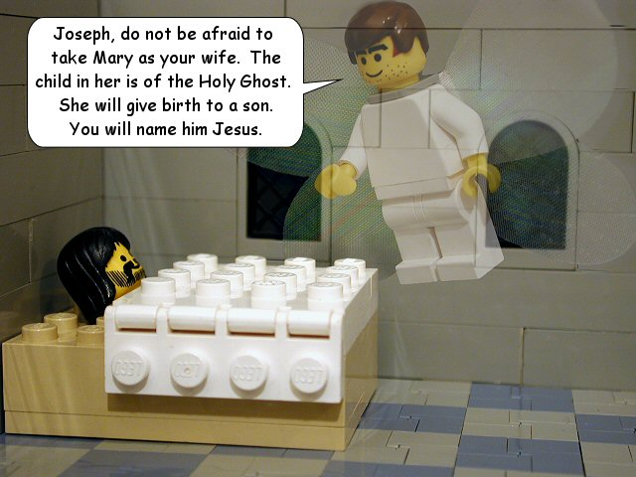
Back to main calendar
8th DECEMBER
Matthew 1:19 Mary was found to be pregnant. Being an upright man, and not wanting to disgrace her in public, Joseph had decided to leave Mary quietly."
Matthew 1:20-21 But as he considered this, an angel appeared to him in a dream, saying, “Joseph, do not be afraid to take Mary as your wife. The child in her is of the Holy Spirit and you will name him Jesus.”

Slide 22
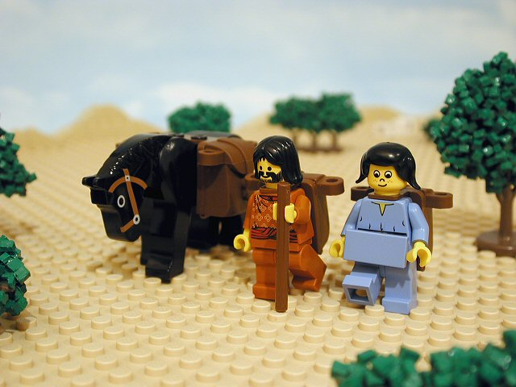
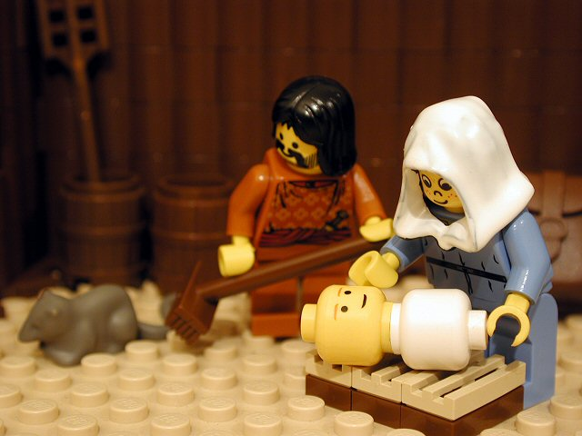
Back to main calendar
9th DECEMBER
Luke 2:1,3-5 Now, Caesar Augustus ordered a census of the Roman Empire, so everyone went to their home towns to be registered. As a descendant of Kind David, Joseph set out from Nazareth to Bethlehem with Mary.
Luke 2:6-7 While they were there, the time came for Mary to deliver her firstborn son. She wrapped him in cloth, and laid him in a manger, because there was no room for them at the inn.

Slide 23
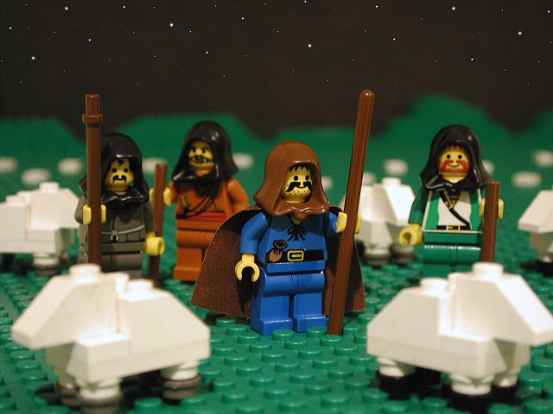
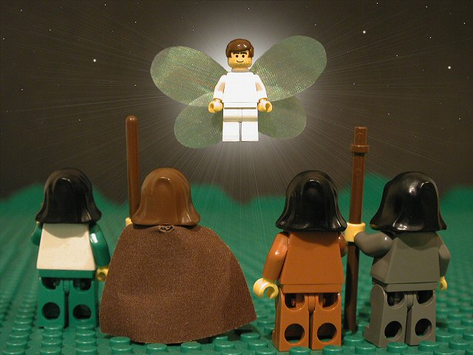
Back to main calendar
10th DECEMBER
Luke 2:8 There were some shepherds out in the nearby fields, keeping watch over their flock at night.
Luke 2:9 An angel of the Lord appeared before them, and the glory of the Lord shone around them. The shepherds were terrified.

Slide 24
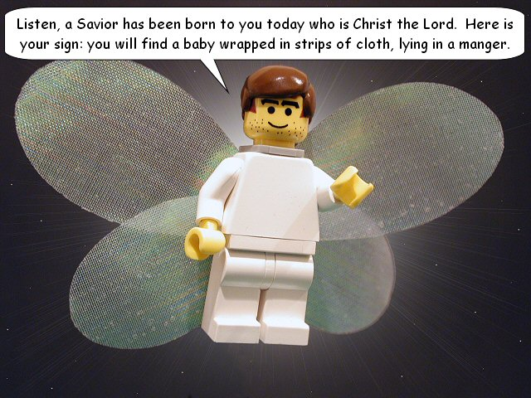
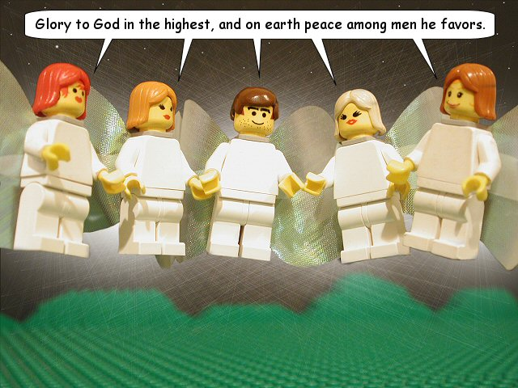
Back to main calendar
11th DECEMBER
Luke 2:10-12 But the angel said, “Don’t be afraid! Listen, a Saviour has been born to you today who is Christ the Lord. Here is your sign: you will find a baby wrapped in strips of cloth, lying in a manger.”
Luke 2:13-16 Suddenly a multitude of the heavenly host was there with the angel, praising God and saying, “Glory to God in the highest, and on earth peace among men he favours.” So the shepherds left in a hurry.

Slide 25
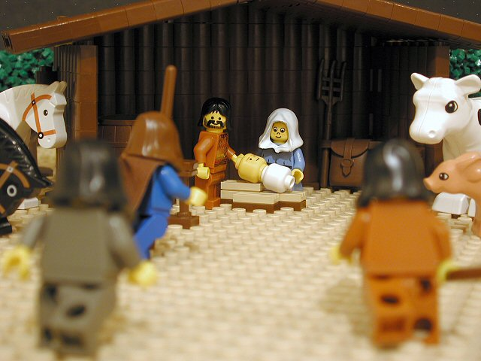
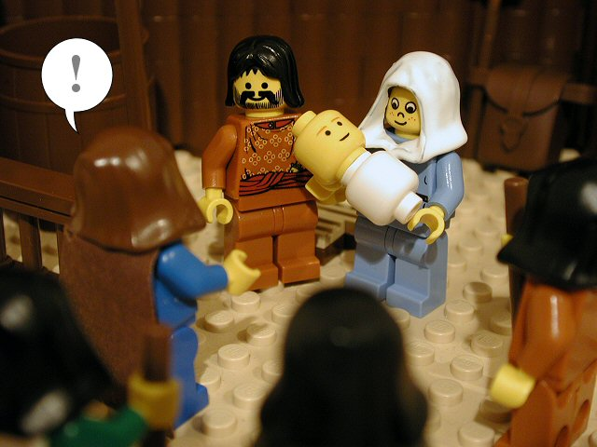
Back to main calendar
14th DECEMBER
Luke 2:16 And they found Mary and Joseph, and the baby was lying in the manger.
Luke 2:17-18 Having seen the baby, the shepherds made known what they had been told about this child, and all who heard it marvelled at the things that the shepherds told them.

Slide 26
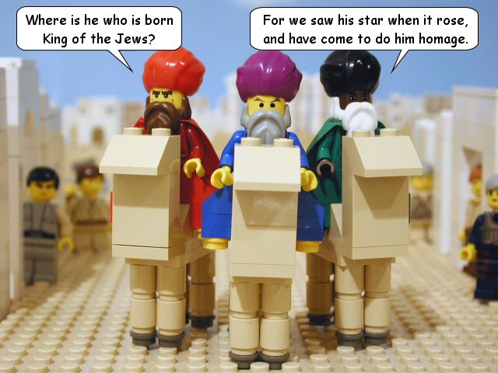
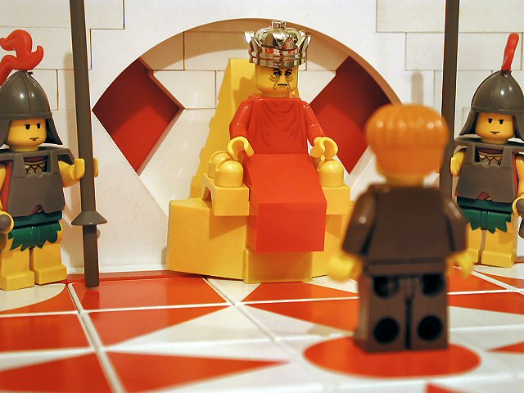
Back to main calendar
15th DECEMBER
Matthew 2:1-2 After Jesus was born, some magi from the east came to Jerusalem, saying, “Where is he who is born King of the Jews? For we saw his star when it rose, and have come to worship him.”
Matthew 2:3-5 When King Herod the king heard about this, he was disturbed. He asked all the chief priests where the messiah was to be born. They said “in Bethlehem, just as was written by the prophet.”

Slide 27
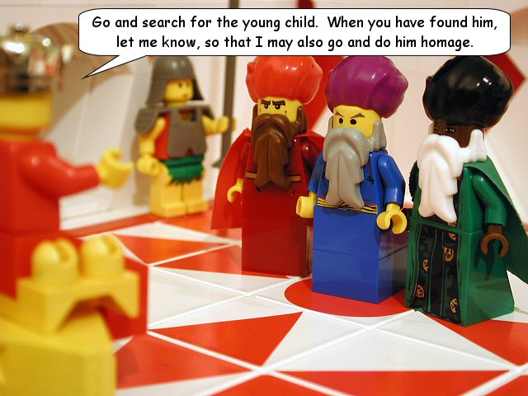
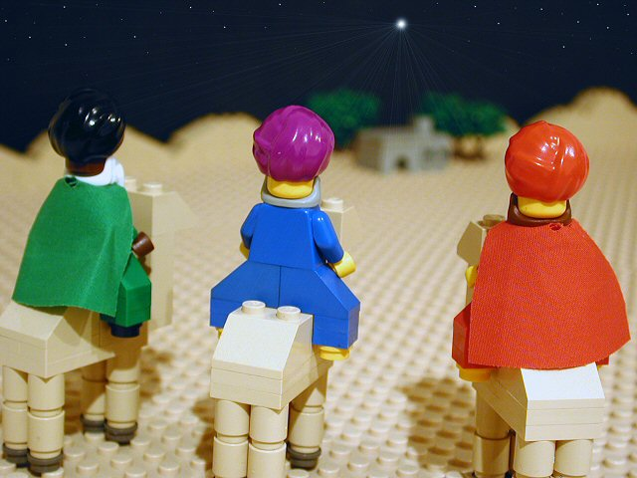
Back to main calendar
16th DECEMBER
Matthew 2:7 Then King Herod summoned the magi. He sent them off to Bethlehem, saying, “Go and search for the young child. When you have found him, let me know, so that I may also go and worship him.”
Matthew 2:9 Having listened to the king, the magi set off. The star that they had seen rising went on before them until it came to a stop over the place where the child was.

Slide 28
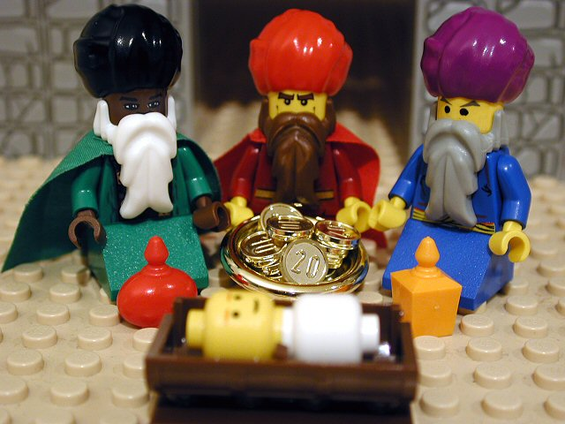
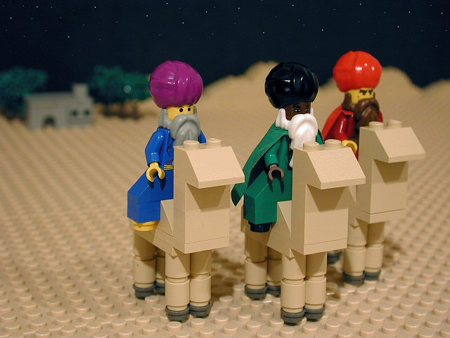
Back to main calendar
17th DECEMBER
Matthew 2:11 They came to the house where Jesus was with Mary. They bowed down and did him homage. Opening their treasures, they offered to him gifts of gold, frankincense, and myrrh.
Matthew 2:12 But the magi were warned in a dream that they should not return to King Herod, and so they travelled back to their own country by a different route.

Slide 29
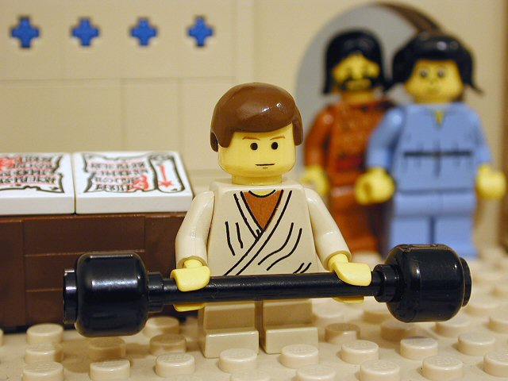
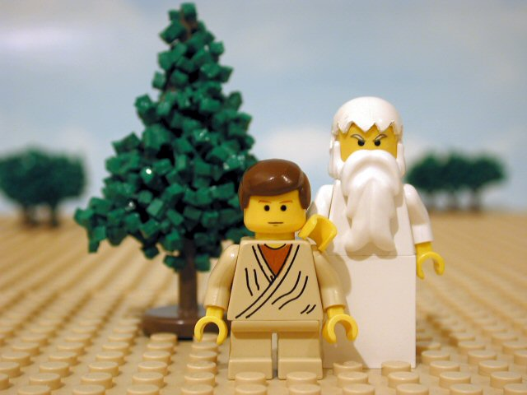
Back to main calendar
18th DECEMBER
Luke 2:40 The child grew and became strong and full of wisdom.
Luke 2:40 And God's favour was with him.

